Slide 1
High Speed Networks MPLS, LDP, RSVP-TE, TE
Robert Iakobashvili,
Author: Akiva Sadovski from Broadcom
Spring 2022

Slide 2
What Is MPLS?
Multi
Protocol
Label
Switching
MPLS relies on associating a small, fixed format label with each data packet
Notes:
Allow core routers/networking devices to switch packets based on some simplified header
Leverage hardware so that simple forwarding paradigm can be used
It has evolved a long way from the original goal.

Slide 3
MPLS Timeline
Notes:
IP addresses are allocated hierarchically: IP addresses that share the same prefix often share the same next hop. This reduces the routing table size and enhances scalability
When looking up a DIP in the routing table, several entries with different prefixes may match it.
The entry chosen is the one with the Longest Prefix Match (LPM)
HW LPM implementation was problematic in the 90-s
Therefore Cisco suggested to add a fixed length identifier to IP packets to speed up routing decisions

Slide 4
Where it is used?
MPLS packets can run on Layer 2 technologies such as ATM, FR, PPP, PoS, Ethernet
Other Layer 2 technologies can be run over an MPLS network: Ethernet-over-MPLS, FrameRelay-over-MPLS etc
Currently, MPLS is a technology for delivery of IP Services:
Virtual Circuit for IP: Unidirectional path (tunnel) through the network
Traffic Engineering: Using paths other than the IGP shortest-path

Slide 5
MPLS LSP
Unidirectional path through the network
Notes:
Official definition (from RFC3031): The path through one or more LSRs at one
level of the hierarchy followed by a packets in a particular FEC.

Slide 6

MPLS Router Types
Ingress LSR (Label Edge Router, LER)
Packets enter the LSP at the Ingress Router
Classifies packets and assign them to LSPs
Upstream from other routers in the LSP
Performs a label push operation
Transit LSR
Performs a label swap operation
Penultimate LSR
Immediate upstream router from the egress router
the label stack may be popped at the penultimate LSR of the LSP, rather than at the LSP Egress.
Egress LSR
Packets exit the LSP
Downstream from other routers in the LSP
Can perform a label pop operation

Slide 7
MPLS Label
Label – 20 bit wide ID
TC - Traffic Class or CoS (previous name – EXP)
S - Bottom Of Stack (BoS)
TTL - Time To Live

Slide 8
MPLS Label – Contd.
The label determine the path the packet shall follow
Has local significance
Labels usually change on each network segment
Label space
Platform-wide
Per-Interface

Slide 9
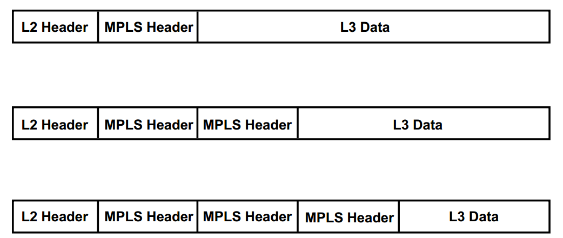
MPLS Label Stacking
MPLS supports a hierarchy, however the processing of a labeled packet is completely independent of the level of hierarchy
Multiple labels may be stacked together
The processing is always based on the top label

Slide 10
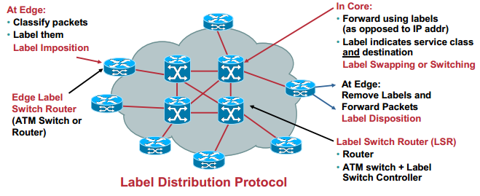
MPLS concepts

Slide 11
Forwarding Equivalence Class
Packet headers contain considerably more information than is needed simply to choose the next hop.
Choosing the next hop can therefore be thought of as the composition of two functions:
The first function partitions the entire set of possible packets into a set of "Forwarding Equivalence Classes (FECs)".
The second maps each FEC to a next hop.
Putting it simply:
FEC determines how packets are mapped to LSPs

Slide 12
Inside MPLS router
Notes:
From RFC3031:
About FEC: “In conventional IP forwarding, a particular router will typically
consider two packets to be in the same FEC if there is some address
prefix X in that router’s routing tables such that X is the "longest
match" for each packet’s destination address.”
ILM definition: “The "Incoming Label Map" (ILM) maps each incoming label to a set of
NHLFEs. It is used when forwarding packets that arrive as labeled
packets.”
Next Hop: “The "Next Hop Label Forwarding Entry" (NHLFE) is used when forwarding
a labeled packet. It contains the following information:
1. the packet’s next hop
2. the operation to perform on the packet’s label stack; this is one
of the following operations:
a) replace the label at the top of the label stack with a specified new label
b) pop the label stack
c) replace the label at the top of the label stack with a specified new label, and then push one or more specified new
labels onto the label stack.
It may also contain:
d) the data link encapsulation to use when transmitting the packet
e) the way to encode the label stack when transmitting the packet
f) any other information needed in order to properly dispose of
the packet.”

Slide 13
Inside mpls router: simplified view

Slide 14
Reserved labels
Labels 0 through 15 are reserved labels.
Value Description Reference
0 IPv4 Explicit NULL Label [RFC3032]
1 Router Alert Label [RFC3032]
2 IPv6 Explicit NULL Label [RFC3032]
3 Implicit NULL Label [RFC3032]
4-6 Unassigned
7 Entropy Label Indicator (ELI) [RFC6790]
8-12 Unassigned
13 GAL Label [RFC5586]
14 OAM Alert Label [RFC3429]
15 Unassigned
Notes:
An egress LSR assigns the implicit NULL label to a FEC if it does not want to assign a label to that FEC, thus requesting the upstream LSR to perform a pop operation. In the case of a plain IPv4-over-MPLS network, such as an IPv4 network in which LDP distributes labels between the LSRs, the egress LSR—running Cisco IOS—assigns the implicit NULL label to its connected and summarized prefixes.
The use of implicit NULL adds efficiency when forwarding packets. However, it has one downside: The packet is forwarded with one label less than it was received by the penultimate LSR or unlabeled if it was received with only one label. Besides the label value, the label also holds the Experimental (EXP) bits.
The Router Alert label is the one with value 1. This label can be present anywhere in the label stack except at the bottom. When the Router Alert label is the top label, it alerts the LSR that the packet needs a closer look. Therefore, the packet is not forwarded in hardware, but it is looked at by a software process.

Slide 15
MPLS Route Selection
Hop by Hop routing
Explicit routing:
each LSR does not independently choose the next hop
a single LSR, generally the ingress LSP or the egress LSP does the job
Notes:
Q. What to do with the packet that lacks the outgoing label?

Slide 16
Label Switching Path
Notes:
LER A:
Class Rule 1: PUSH 150
Class Rule 2: PUSH 100
LSR B:
ILM:
Ingress=eth1, InLabel=150, SWAP, OutLabel=250, Egress=eth2
Ingress=eth1, InLabel=100, SWAP, OutLabel=110, Egress=eth2
LSR C:
ILM:
Ingress=eth1, InLabel=250, SWAP, OutLabel=350, Egress=eth2
Ingress=eth1, InLabel=110, SWAP, OutLabel=120, Egress=eth3
LER D
ILM:
Ingress=eth1, InLabel=350, POP, OutLabel=N/A, Egress=eth2
LER D
ILM:
Ingress=eth1, InLabel=120, POP, OutLabel=N/A, Egress=eth2

Slide 17
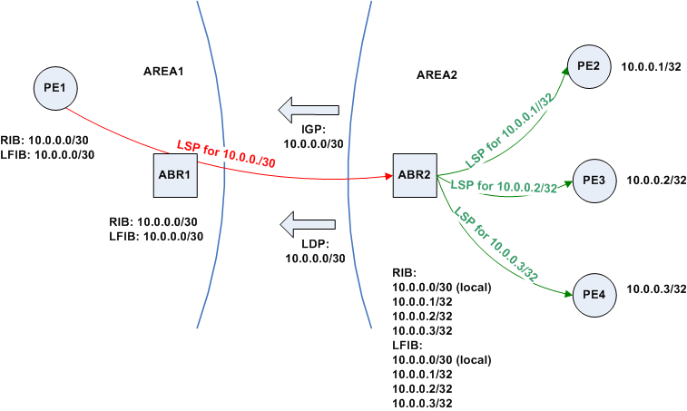
LSP Aggregation
The procedure of binding a single label to a union of FECs which is itself a FEC (within some domain), and of applying that label to all traffic in the union, is known as "aggregation".
Aggregation may reduce the number of labels which are needed to handle a particular set of packets, and may also reduce the amount of label distribution control traffic needed.
Notes:
Granularity issues

Slide 18
LSP tunnels
LSR takes explicit action to cause a particular packet to be delivered to another LSR:
even though the routers are not consecutive routers on the Hop-by-hop path for that packet
target router is not the packet’s ultimate destination
Hierarchy: LSP within LSP
Notes:
The higher level label can be encoded as the lower level label attribute, then the lower label is distributed to local label distribution peers along with this attribute.

Slide 19
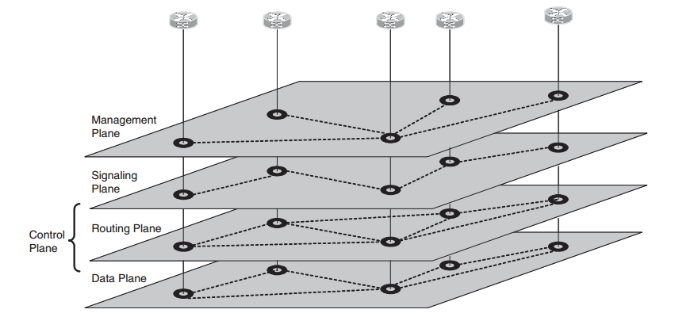
Functional Components and Planes in the network
The network may be sliced into sets of functional components that communicate with each other and all of which have related responsibilities. These slices are called planes.
Communication between planes takes place only within a network node.
Communications between network nodes take place only within a plane.
From: GMPLS Architecture and Applications by Adrian Farrel and Igor Bryskin
Notes:
For example, the management component on one node does not talk to the data
processing component on another node.

Slide 20
MPLS Data Plane and Control Plane
Control Plane—responsible for maintaining correct label tables among Label Switching Routers
Forwarding (aka Data) Plane—uses label carried by packet and label table maintained by LSR to forward the packet
Notes:
The control plane performs transport path control functions.
Through signaling, the control plane sets up, modifies and releases transport paths, and may recover a transport path in case of a failure.
Control Plane—responsible for maintaining correct label tables among Label Switching Routers
Forwarding (aka Data) Plane—uses label carried by packet and label table maintained by LSR to forward the packet

Slide 21
MPLS Labels Distribution
Label distribution protocol is a set of procedures by which one Label Switched Router (LSR) informs another of the meaning of labels used to forward traffic between and through them
MPLS architecture does not assume a single label distribution protocol
Label Distribution Protocols:
LDP –auto discovery, session (TCP) based (RFC5036)
RSVP-TE – RSVP extension capable of labels dissemination (RFC3209)

Slide 22
MPLS Labels Distribution Types
Two types of MPLS Label Distribution:
Downstream-on-Demand
“Ask and you shall receive”
Unsolicited Downstream
Sent without a request
“Here’s a label to use for this prefix”
Notes:
The MPLS architecture allows an LSR to explicitly request, from its
next hop for a particular FEC, a label binding for that FEC. This is
known as "downstream-on-demand" label distribution.
The MPLS architecture also allows an LSR to distribute bindings to
LSRs that have not explicitly requested them. This is known as
"unsolicited downstream" label distribution.

Slide 23
MPLS Data Plane and Control Plane - 2
Official definitions (from RFC5654):
The control plane performs transport path control functions. Through signaling, the control plane sets up, modifies and releases transport paths, and may recover a transport path in case of a failure. The control plane also performs other functions in support of transport path control, such as routing information dissemination.

Slide 24
MPLS Label Distribution and Management
Downstream On Demand | Downstream Unsolicited
Sends the label binding only in response to an explicit request from another LSR | Sends label bindings to LSRs that have not explicitly requested them

Slide 25
MPLS Label Distribution and Retention
Label Distribution Control |  | Label Retention
Independent | Ordered | Conservative | Liberal
Each LSR may advertise label mappings to its neighbors at any time it desires | Transmits label mapping: For a FEC for which it has a label mapping for the FEC next hop For a FEC for which the LSR is the egress | Received label mappings are retained only if they will be used to forward packets (i.e., if they are received from a valid next hop according to routing) | Every label mappings received from a peer LSR is retained regardless of whether the LSR is the next hop for the advertised mapping
Notes:
Conservative Label Retention – next hops (next hop in most cases) are best next hop(s) determined by the IGP metric;
Liberal Label Retention – keeps binding from all LSRs.
Independent LSP control – if LSR has a prefix in its routing table, it advertises the corresponding binding despite the fact that there can be no LSP to the target (specified by the prefix).
Ordered LSP control – the binding is advertised if LSR is the egress or the LSP to the target (prefix) exists.
Most prefer the Ordered LSP control.
RSVP-TE implements the Conservative Label Retention and Ordered LSP Control.

Slide 26
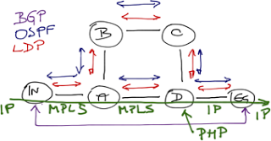
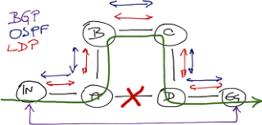
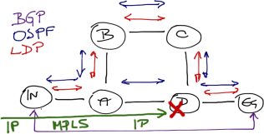
Label distribution and a core link failures
Default settings on most modern routers:
independent label distribution
liberal label retention mode
Every LSR saves labels advertised by all its neighbors
Therefore when A discovers that it can use B to reach the egress router, it already has the label assigned by B to EG prefix in its Label Information Base (LIB)

Slide 27
MPLS Label Distribution Peering and Hierarchy
… sending label distribution protocols to the peer
Explicit peering;
Implicit peering: to distribute higher level labels to LSR remote label distribution peers, the router encodes a higher level label as an attribute of a lower level label, and then distributes the lower level label, along with this attribute

Slide 28

Label Distribution Protocol
Notes:
This is another option for an Overview slides using transitions.

Slide 29
Label Distribution Protocol (LDP)
The protocol is
a set of procedures by which one Label Switched Router (LSR) informs another of the meaning of labels used to forward traffic between and through them
MPLS architecture does not assume a single label distribution protocol
Existing protocols can also be used

Slide 30
LDP Message Exchange
Four categories of LDP messages:
Discovery messages, used to announce and maintain the presence of an LSR in a network.
Session messages, used to establish, maintain, and terminate sessions between LDP peers.
Advertisement messages, used to create, change, and delete label mappings for FECs.
Notification messages, used to provide advisory information and to signal error information.

Slide 31
Label spaces, identifiers, LDP sessions
Label space can be:
Per interface
Per platform (device, LSR)
LDP identifier
6 bytes
Consists of LSR ID (4 bytes) and Label Space ID (2 bytes)
LDP sessions exist between LSRs to support label exchange between them
LDP session can be established between directly connected and non directly connected LSRs

Slide 32
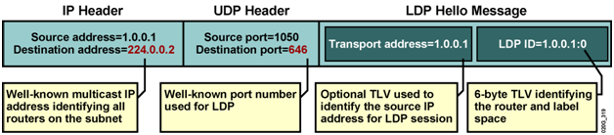
LDP messages transport
Discovery is done by sending a Hello message periodically
UDP packet to the LDP port at the ’all routers on this subnet’ (224.0.0.2) group multicast address;
Session, Advertisement, and Notification
Use the TCP transport.

Slide 33
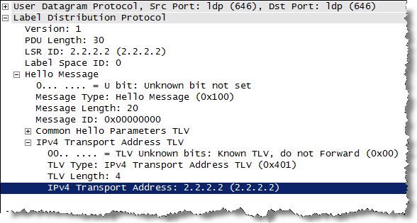
LDP Discovery mechanisms
Basic Discovery Mechanism
LSR periodically sends LDP Link Hellos out the interface
Hello sent by an LSR carries the LDP Identifier for the label space the LSR intends to use
Receipt of an LDP Link Hello on an interface identifies a "Hello adjacency“
Extended Discovery Mechanism
For LDP sessions between non-directly connected LSRs
LSR periodically sends LDP Targeted Hellos to a specific address
LDP Targeted Hellos are sent as UDP packets addressed to the well-known LDP discovery port at the specific address
Notes:
Extended Discovery might be used to support LDP Sessions between Non-Directly Connected LSRs

Slide 34
LDP Session Establishment
Consists of
Transport connection establishment
Session initialization
Transport connection establishment:
The address is taken from the Hello’s Transport Address optional object (TLV) or from the Hello’s source address
Active and passive roles are determined by comparing addresses
Notes:
Unlike Basic Discovery, which is symmetric, Extended Discovery
is asymmetric.

Slide 35
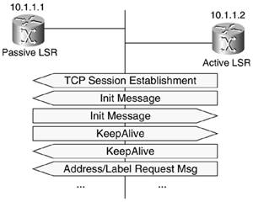
LDP Session Initialization
LDP Initialization message carries negotiated parameters:
LDP protocol version
label distribution method
timer values
VPI/VCI ranges for label controlled ATM
DLCI ranges for label controlled Frame Relay, etc.
The Initialization message carries both the LDP Identifier for the sender’s (active LSR’s) label space and the LDP Identifier for the receiver’s (passive LSR’s) label space
KeepAlive message signals acceptance of the peer’s parameters
Maintaining LDP Sessions
LDP PDU at least every KeepAlive time period
sends KeepAlive message if nothing to send
Notes:
After the connection is established, if LSR1 is playing the active
role, it initiates negotiation of session parameters by sending an
Initialization message to LSR2. If LSR1 is passive, it waits for
LSR2 to initiate the parameter negotiation.

Slide 36
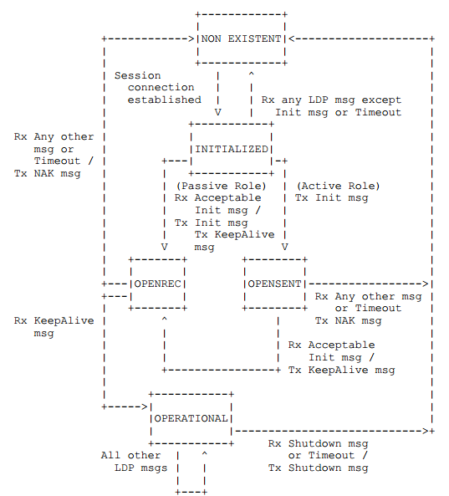
LDP Initialization State Machine

Slide 37
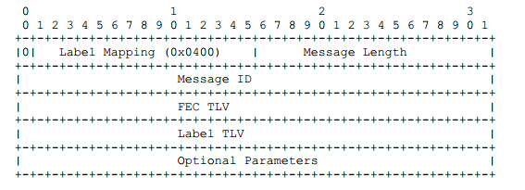
LDP Label Mapping Message
An LSR sends a Label Mapping message to an LDP peer to advertise FEC-label bindings to the peer
When using independent LSP control, each LSR may advertise label mappings to its neighbors at any time it desires
When using LSP Ordered Control, an LSR may initiate the transmission of a label mapping only for a FEC for which it has a label mapping for the FEC next hop, or for which the LSR is the egress
Notes:
Ordered LSP control – the binding is advertised if LSR is the egress or the LSP to the target (prefix) exists.

Slide 38
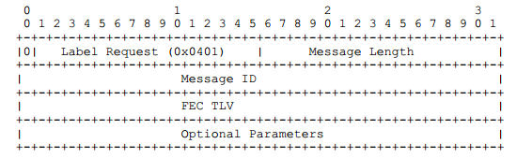
LDP Label Request Message
The MPLS architecture [RFC3031] allows an LSR to distribute a FEC label binding in response to an explicit request from another LSR. This is known as Downstream On Demand label distribution.
An LSR sends the Label Request message to an LDP peer to request a binding (mapping) for a FEC.

Slide 39
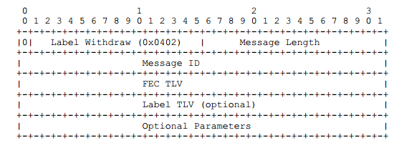
LDP Label Withdraw Message
Breaks the mapping between the FECs and the labels (Downstream Unsolicited)

Slide 40
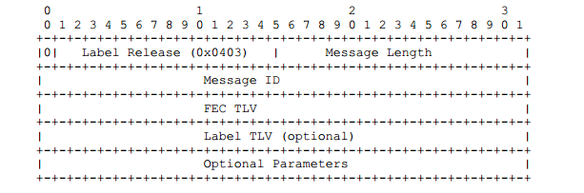
LDP Label Release message
Signal the peer that the LSR no longer needs specific FEC-label mappings previously requested of and/or advertised by the peer

Slide 41
LDP Address and Address Withdraw messages
LSR must be able to find the address corresponding to the next hop
when the next hop for IP address prefix changes LSR releases the label
Notes:
For Conservative Label Retention

Slide 42
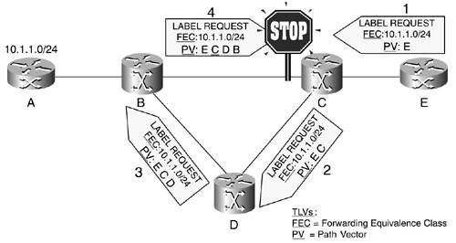
LDP Loop Detection
Optional Loop Detection mechanisms
Path Vector TLV contains a list of the LSRs that the message has traversed
Hop Count TLV contains a count of the LSRs message has traversed
Time to Live (TTL) field in the MPLS shim header

Slide 43
Yet Another Label Distribution Protocol: RSVP
Notes:
This is another option for an Overview slides using transitions.

Slide 44
RSVP extensions overview - 1
Additions to RSVP signaling protocol
Signaling is the process of exchanging messages within the control plane to create, maintain, modify and terminate the data paths in the data plane
In MPLS context, these data paths are LSPs
Notes:
RSVP is easily extendable - there are objects that:
-- must cause an error if not supported;
-- can be dropped if not supported;
-- must be forwarded unmodified if unsupported.

Slide 45
RSVP extensions overview - 2
Leverage the admission control mechanism of RSVP to create an LSP with bandwidth
Label requests (LABEL_REQUEST objects) are sent in PATH messages with a session type of LSP_TUNNEL and binding is done with RESV messages
EXPLICT-ROUTE object defines the path over which setup messages should be routed (can be incorporated into the PATH message)
Using RSVP has several advantages

Slide 46
RSVP advantages
Using RSVP has several advantages:
Once the sender node discovers a better route, the sender can dynamically reroute the session by simply changing the EXPLICIT_ROUTE object (ERO)
By adding a RECORD_ROUTE object (RRO) to the Path message, the sender node can receive information about the actual route that the LSP tunnel traverses
A SESSION_ATTRIBUTE object can be added to Path messages to aid in session identification and diagnostics. Additional control information, such as setup and hold priorities, resource affinities and local-protection, are also included in this object

Slide 47
RSVP Path and Resv Messages
Path messages are sent downstream
Addressed to the egress router
Contains the router alert option
Establishes protocol state along the way
Resv are messages sent upstream
Addressed to the next upstream node
Finalizes protocol state
Assigns and allocates resources

Slide 48
RSVP Path Message Objects
Objects used to define the LSP and request resources
Session
Defines the address of the egress router
Contains the Tunnel ID value associated with the LSP
RSVP-Hop
Interface address of the previous hop of the LSP
Sender-Template
Defines the address of the ingress router
Contains a unique LSP ID
Sender-Tspec
Displays any request bandwidth reservations
Session Attribute
Contains LSP priority values as well as the ASCII name of the LSP

Slide 49
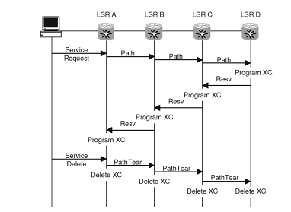
RSVP Path vs Resv
The Resv message is sent back upstream towards the sender, following the path state created by the Path message, in reverse order
Note that if the path state was created by use of an ERO, then the Resv message will follow the reverse path of the ERO
Notes:
Each node that receives a Resv message containing a LABEL object uses
that label for outgoing traffic associated with this LSP tunnel. If
the node is not the sender, it allocates a new label and places that
label in the corresponding LABEL object of the Resv message which
This label also serves as
shorthand for the Filter Spec. The node can now update its "Incoming
Label Map" (ILM), which is used to map incoming labeled packets to a
"Next Hop Label Forwarding Entry" (NHLFE)it sends upstream to the PHOP.

Slide 50
RSVP Resv Message Objects - 1
Objects used to allocate resources and establish the LSP
Session
Contains the egress address and Tunnel ID
RSVP-Hop
Interface address of the downstream hop of the LSP
Style – sender has no influence on the reservation style selection
The Fixed Filter (FF) reservation style creates a distinct reservation for traffic from each sender that is not shared by other senders.
The Shared Explicit (SE) style allows a receiver to explicitly specify the senders to be included in a reservation. There is a single reservation on a link for all the senders listed.
FlowSpec
Displays the bandwidth reserved by the LSP
Matches the information in the Sender-Tspec object
Notes:
Path messages from different senders can each carry their own ERO,
and the paths taken by the senders can converge and diverge at any
point in the network topology. When Path messages have differing
EXPLICIT_ROUTE objects, separate LSPs for each EXPLICIT_ROUTE object
must be established.

Slide 51
RSVP Resv Message Objects - 2
Objects used to define the LSP and request resources
Filter-Spec
Contains the ingress address and LSP ID
Matches the information in the Sender-Template object
Label
Contains the 20-bit label value to be used for traffic forwarding
Record Route
Contains the actual path of the LSP through the network
Used for loop detection and prevention
Notes:
The destination node of a label-switched path responds to a
LABEL_REQUEST by including a LABEL object in its response RSVP Resv
message.

Slide 52
RSVP Bandwidth
By default, each interface uses 100% of its capacity as reservable bandwidth
You may change this percentage
An LSP may request a bandwidth reservation during its establishment in the network
Only determines if the LSP is setup of not
The BW reservation is NOT used to police traffic
For instance, in the traffic engineering application, it is very useful to use the Path message as a means of verifying that bandwidth exists at a particular priority along an entire path before preempting any lower priority reservations

Slide 53
Explicit Route Object (ERO)
The ERO specifies that the LSP originating at LSR A must pass through LSRs B, E, and then terminate at C
The individual hops specified by the ERO can be either strict or loose
A strict hop means that the specified LSR must be directly connected to the previous hop;
A loose hop means that the path must pass through the specified LSR, but the LSR does not have to be directly connected to the last hop; any valid route between the two can be used
The sub-object of an ERO can specify the address of an interface through which the data shall arrive to LSR, or the address of interface out of which the data should be sent from the LSR

Slide 54
Explicit Route Object creation
The ingress LSR creates the ERO
One way: to configure manually
A second way for the ingress LSR to determine the ERO is to dynamically calculate it by Constrained Shortest Path First (CSPF) algorithm
While Path message progresses:
When the EXPLICIT_ROUTE object (ERO) is present, the Path message is forwarded towards its destination along a path specified by the ERO
Each node along the path records the ERO in its path state block
Nodes may also modify the ERO before forwarding the Path message. In this case the modified ERO SHOULD be stored in the path state block in addition to the received ERO
Notes:
Labels can also be provided.

Slide 55
Explicit Route Object use
The network tends to be divided into computational domains
Loose hops are used usually to identify a sequence of computational domains
The ERO may contain non specific hops:
These may be expressed as IP prefixes
Or Autonomous Systems (AS) numbers
Such non specific hops can be marked loose or strict according to whether they must be reached directly or may be arrived indirectly from the previous hop
The control plane can record and report the actual LSP route via RRO. The addresses of interfaces and LSRs traversed by LSP are encoded in the RRO just as they would be for ERO

Slide 56
RSVP tunnel maintenance
Path messages are re-transmitted (for reliable delivery) thus refreshing the tunnel
The downstream router can assume that the resources are no more required if it does not see the retransmitted Path message during reasonable period of time
LSP modifications:
Relatively few LSP parameters permit the in-place modification (for example LSP route recording can be turned on or off in place)
The alternative is make-before-break
Notes:
In make-before-break two LSPs shall have the very similar identities:
The same Session object;
Sender Template differs only in LSP ID.

Slide 57
RSVP Error Cases
Upstream Error message:
Informs that the Path request cannot be satisfied
Can supply sufficient information for LSP to be re-routed
Is used to report problems and failures with already established LSP
Downstream Error messages:
Informs that the upstream LSR cannot satisfy the reservation request carried in the Resv message
Both Downstream Error and Upstream Error messages do not remove the LSP unless the Downstream Error message issued during LSP establishment will gradually unpick the LSP

Slide 58
Rerouting RSVP tunnels
Capability to reroute an established TE tunnel under a number of conditions:
When a more "optimal" route becomes available
Upon failure of a resource along the TE tunnel’s established path
It is highly desirable not to disrupt traffic during tunnel re-routing
Establish a new LSP tunnel
Transfer traffic from the old tunnel to the new before tearing down the old LSP tunnel
Notes:
The combination of the LSP_TUNNEL SESSION object and the SE
reservation style naturally accommodates smooth transitions in
bandwidth and routing. The idea is that the old and new LSP tunnels
share resources along links which they have in common.

Slide 59
How reroute is done
The ingress node picks a new LSP ID and forms a new SENDER_TEMPLATE, then creates a new ERO to define the new path
The ingress node sends a new Path Message using the original SESSION object and the new SENDER_TEMPLATE and ERO
It continues to use the old LSP and refresh the old Path message
On links that are not held in common, the new Path message is treated as a conventional new LSP tunnel setup
On links held in common, the shared SESSION object and SE style allow the LSP to be established sharing resources with the old LSP
Once the ingress node receives a Resv message for the new LSP, it can transition traffic to it and tear down the old LSP

Slide 60
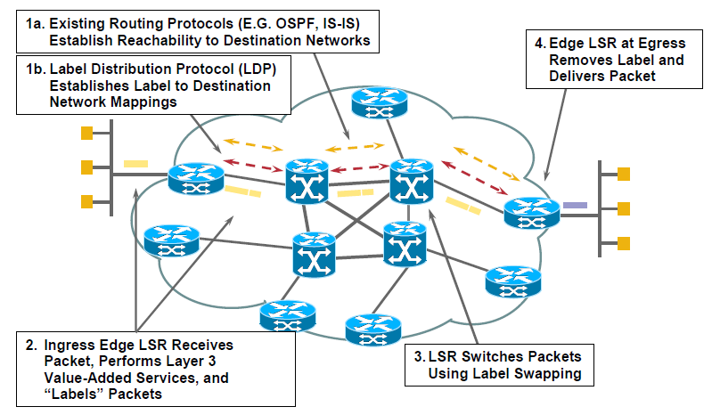
MPLS – Bringing it all together
Notes:
If, after a session has been successfully established, the sender
node discovers a better route, the sender can dynamically reroute the
session by simply changing the EXPLICIT_ROUTE object.

Slide 61
Introduction to MPLS-TE

Slide 62
Definition of Traffic Engineering
RFC 2702,Requirements for Traffic Engineering Over MPLS:
traffic engineering is a technology that is concerned with performance optimization of operational networks

Slide 63
Traffic-oriented objectives
Traffic-oriented and hence directly visible to end users:
Quality of Service (QoS) enhancement of traffic streams
minimization of data loss
minimization of delay
the provision of a certain level of throughput for high-priority traffic flows in conditions when some network links are congested

Slide 64
Resource-oriented objectives
Important only to Service Providers and irrelevant to users of services they sell
Optimization of resource utilization
Notes:
Given the network resources that I have, how can I keep all my
users happy? Can I sell more services without adversely affecting my current users?
How can I avoid the situation where some network resources are severely overused
while others are underused or not used at all? What network assets can I add,
and where do I need to add them, in order to improve my network performance?
How can I protect the services that I sell from network outages?

Slide 65
TE in Internet
Traffic Engineering is needed in the Internet mainly because current IGPs always use the shortest paths to forward traffic
Using shortest paths cause the following problems:
The shortest paths from different sources overlap at some links, causing congestion on those links
The traffic from a source to a destination exceeds the capacity of the shortest path, while a longer path between these two routers is under-utilized
One day network capacity will become so cheap that there will be no need in traffic engineering

Slide 66
A network from the TE standpoint
A network consists of:
Demand system (traffic)
Constraint system (interconnected network elements)
Response system (protocols and processes)

Slide 67
Traffic Engineering in packet network
Distribution of topology information: Because the network is a distributed system, it is necessary to have a mechanism to advertise up-to-date information about links to all nodes in the network. A node can then build a topology map of the network
Path selection: This involves using the topology information gathered to compute reachability information between nodes in the network
Directing traffic along the selected paths
Traffic management: definition of QoS metrics

Slide 68
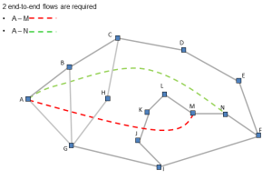
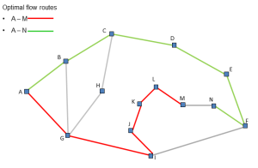
MPLS TE capabilities
Explicit routing
Constraint-based routing
Bandwidth reservation
Source: Routing and Network Optimization
Notes:
MPLS Traffic engineering protocols allow nodes to advertise not just their
presence and topological connectivity, but attributes of their links as well. This
makes it possible for provider network edge nodes or off-line path computation
elements to compute paths with the necessary constraints; therefore, services
taking the paths have a good likelihood to be successfully established and
operational.

Slide 69
Traffic Engineering toolbox – Link State Synchronization
The following link attributes are introduced for the purpose of link
synchronization :
Reservable bandwidth
Link type
Link ID
Local interface IP address (for numbered TE links)
Remote interface IP address (for numbered TE links)
Local link identifier (for unnumbered links)
Remote link identifier (for unnumbered links)
Notes:
TE Link Advertisement shall be consistent

Slide 70
Traffic Engineering toolbox – Constrained Based Routing
Constrained based routing:
computes routes that are subject to constraints such as bandwidth and administrative policy
may find a longer but lightly loaded path better than the heavily loaded shortest path

Slide 71
Link Attributes for CBR
Traffic engineering metric
Administrative group
Link protection type
Shared Risk Link Group (SRLG)
Interface Switching Capability descriptor
Notes:
The Traffic engineering metric attribute is used as a cost of the arc
that represents the TE link on the TE network graph in the direction from
the data switch with which the advertising controller is associated.
The Administrative group attribute is a 32-bit number that may be advertised
for a TE link
The Link protection type attribute represents the TE link protection
capabilities.
The Shared Risk Link Group attribute identifies all SRLGs to which the link
belongs. As mentioned earlier, several links can constitute an SRLG if they share
a network resource whose failure may affect all links in the group.

Slide 72
LSP color (affinity)
Color can be assigned to LSPs and links to achieve some desired LSP placement
For instance:
All regional links can be colored green, and all inter-region links can be colored red
Regional LSPs will be constrained to take only green links
regional LSPs will never traverse any inter-region link

Slide 73
MPLS Traffic Engineering protocols: OSPF-TE
OSPF-TE makes use of the OSPF opaque LSA option introduced in RFC 2370.
The TE LSA payload is structured as a set of Type-Length-Value blocks (TLVs).
Top-level TLVs may nest other TLVs (sub-TLVs) within themselves.
Two types of TE top-level TLVs are currently defined:
Router Address (may be used to uniquely identify the advertising controller)
TE Link (used to advertise attributes of one TE link)
Notes:
Each TE link attribute is encoded as a separate sub-TLV

Slide 74
MPLS Traffic Engineering protocols: ISIS-TE
IS-IS speakers use Link State Protocol Data Units that are composed of multiple TLVs
ISIS-TE defines two new types of TLVs:
The Traffic Engineering Router ID TLV (equivalent to OSPF-TE Router Address TLV)
Extended IS Reachability TLV (equivalent to Link TLVs)
Notes:
Each TE link attribute is encoded as a separate sub-TLV

Slide 75
Load balancing with TE
Multiple parallel LSPs can be configured between an ingress-egress pair.
These LSPs can be placed on different physical paths, so that the traffic load from the source to the destination can be distributed more evenly.
By using multiple parallel LSPs, the size of each LSP is also smaller. These LSPs can be routed more flexibly.

Slide 76
Service Path Re-Optimization
It is possible that after a service has been established, a more efficient path for the service becomes available.
When a better path can be found for one of the previously computed paths, the node or component that originally requested the path can be notified.
In order to take advantage of the new path, the service ingress node must re-route the service onto the new path using the make-before-break technique.

Slide 77
MPLS Path Computation
Path computation is the process of selecting or determining the path.
On-line path computation: in time of service provisioning.
Off-line path computation: ahead of service provisioning.
Centralized path computation.
Distributed path computation.

Slide 78
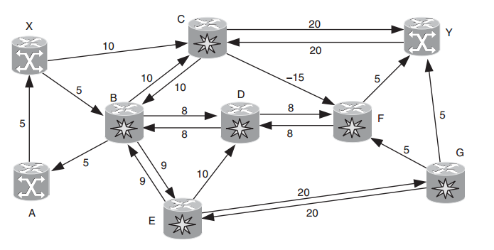
Graph Representation
Connected weighted graph G(V,A),
V{v0, v1,...,vN} - vertices representing transport nodes
A{a0, a1,..., aM} are arcs representing TE links
A path is a sequence of contiguous arcs that interconnects a pair of vertices.
A path is called simple or elementary if it does not contain loops.
Source: GMPLS Architecture and Applications by Adrian Farrel and Igor Bryskin
Notes:
Nodes - (crossconnects, add-drop multiplexers, and so forth) that are capable of originating,
terminating, and/or switching user data traffic;

Slide 79
Path Computation Problems
Single-source shortest path problem: finding the shortest paths from a given vertex to all other vertices.
Single-destination shortest path problem: finding the shortest paths to a given vertex from all other vertices.
Single-pair shortest path problem: finding the shortest path between two given vertices.
All-pairs shortest path problem: finding the shortest paths between every pair of vertices.

Slide 80
Basic Single Source Shortest Paths Algorithms
Breadth First Search (BFS) Algorithm
Acts as Single Source Shortest Paths algorithm if edge length is 1 for all edges
Dijkstra Algorithm
Pro:
Fast (O(|A|∙ log(|V|))
Contra:
Cannot work with edges of negative length
Highly Centralized
Complex data structure (Priority Queue)
Bellman-Ford Algorithm
Pro:
Distributed nature (each V shall know paths computed by surrounding Vs)
Can work with negative edge lengths
Contra:
Slower than Dijkstra Alg - (O(|A|∙ |V|)
Distance Vector Protocol (RIP2) – mutation of Bellman Ford

Slide 81
Basic All Source Shortest Paths Algoritms
The Floyd-Warshall Algorithm
Pro:
Work with negative cycles
Contra:
O(|V|³)
Johnson's Algorithm: one Bellman-Ford + |V| Dijkstra
O(|V|∙|A|∙log(|V|)) [Much better than Floyd-Warshall for sparse graphs!

Slide 82
Disjoint paths computation
Shortest K (K≥2) disjoint path algorithms
Edge-disjoint shortest pair of paths
Vertex-disjoint shortest pair of paths
Simple approach:
Find shortest path
Remove its links
Find next shortest path
Possibility of false alarms about nonexistence of paths
D
E
A
B
C
Z
F

Slide 83
Bhandari algorithm
Algorithm for K edge-disjoint paths
Requires slight modification of Dijkstra shortest path algorithm
G
7
1
2
A
1
B
1
C
1
D
1
Z
1
1
1
1
4
E
3
F

Slide 84
Bhandari algorithm - 1
Run the shortest path algorithm
G
7
1
2
A
1
B
1
C
1
D
1
Z
1
1
1
1
4
E
3
F

Slide 85
Bhandari algorithm - 2
Replace each edge of the shortest path by a single arc directed towards source vertex
Make the length of each of the above arcs negative
G
7
1
2
A
-1
B
-1
C
-1
D
-1
Z
1
1
1
1
4
E
3
F

Slide 86
Bhandari algorithm - 3
Run shortest path algorithm in the modified graph
G
7
1
2
A
-1
B
-1
C
-1
D
-1
Z
1
1
1
1
4
E
3
F

Slide 87
Bhandari algorithm - 4
Replace the negative arcs in the graph with original edges
G
7
1
2
A
1
B
1
C
1
D
1
Z
1
1
1
1
4
E
3
F

Slide 88
Bhandari algorithm - 5
Replace the negative arcs in the graph with original edges
Remove overlapping edges of two paths found
Desired pair of paths results
G
7
1
2
A
1
B
1
C
1
D
1
Z
1
1
1
1
4
E
3
F

Slide 89
Vertex-disjoint shortest paths
Split each vertex into two
Join them by arch of length=0
Replace external edges by two oppositely directed arcs
-1
B
0
B
-1
1
1
1
1
E
F

Slide 90
Constrained-Based Routing (CBR)
Constraint-based path computation algorithms allow things like:
the bandwidth available on links
link protection capabilities
type of network resources associated with the links
to be taken into consideration during the path selection process.
Applications
Traffic Engineering
Fast Re-Route
QoS support
Different from IP routing
CBR is source based whereas IP routing is distributed
CBR needs explicit routing
Support for distribution of link attributes
Notes:
In general, the CBR problem is known to be intractable;
In practice, heuristics are used.

Slide 91
CBR Components
Mechanism for source based path computing
Mechanism to collect necessary information
Constraints (local), attributes, topology
Support forwarding along the computed paths
Notification of residual resources after allocation

Slide 92
Path Computation
To determine one or several shortest paths, but with the condition that the resulting paths satisfy all specified path computation constraints
The objective is to determine paths that consume the minimum network resources and are ‘‘good’’ enough for a particular service

Slide 93
CBR Path Computation Constrains
Exclusions: Do not consider certain links and/or nodes during the path selection.
Inclusions: Make sure that specified links and/or links of specified nodes appear in the selected path(s) in the specified order.
Link-type constraints: Do not consider links for which one of the link evaluating functions specified by the user returns FALSE.
Path-type constraints: Disregard paths or path segments, for which one of the path-evaluating functions specified by the user returns FALSE.

Slide 94
Handling of exclusions
Global exclusions can be handled by:
pruning out from the network graph arcs and vertices that represent links and nodes that are to be excluded, and then
running the appropriate diverse path computation algorithm
R8
R3
150
R4
150
R5
R2
150
R1
R6
R7
150
Under utilized
150

Slide 95
Handling of inclusions
can be formulated as a request to compute one or several edge- or best-disjoint paths, each of them crossing the specified ordered list of nodes
from the source to the first inclusion
from the first inclusion to the second inclusion, and so on
until the shortest path from the last inclusion to the destination
R8
R3
150
R4
150
R5
R2
150
R1
R6
R7
150
Under utilized
150

Slide 96
Handling of Link Type Constrains
Augmenting a request with a set of link evaluation functions, and use this to compute a single path, or two or more edge-, vertex-, or best-disjoint paths
Each such evaluation function takes one or more attributes of a link as input, and returns:
TRUE if the link is a good candidate for one of the paths
FALSE otherwise
R8
R3
150
R4
150
R5
R2
150
R1
R6
R7
150
Under utilized
150

Slide 97
Handling of Path-Type Constraints
Initialize the KSP algorithm for generating paths from vertex R1 to vertex R5.
Request the KSP algorithm to return the next shortest path from vertex R1 to
vertex R5.
Compute all relevant path attributes for the retuned path and call all path evaluating functions specified by the user.
If all of the functions return TRUE, terminate the algorithm and return the path as the resulting path.
Otherwise, go to step 2.
R8
R3
150
R4
150
R5
R2
150
R1
R6
R7
150
Under utilized
150
Notes:
Note: Just as in the method described earlier that uses a modified single-pair
shortest path algorithm, path attributes/constraints must be differentiated
depending on whether all links contribute to the path attribute in the same way.
If not, paths cannot be discarded when the path constraint is violated until they
reach the destination.

Slide 98
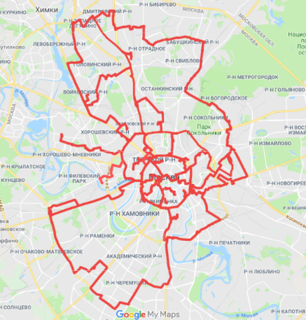
Fast ReRoute (FRR)
FRR is a local recovery technique introduced in MPLS for the protection of packet switching network services
Every node while processing RSVP Path may realize that the LSP is requested to be FRR protected
Indication of such requirement:
The presence of the special object (Fast Re-Route)
Certain flags in Session-Attribute object
Types of protection supported by FRR
Local
Link
Node
Path

Slide 99
FRR terminology
Protected LSP: An LSP is said to be protected at a given hop if it has one or multiple associated backup tunnels originating at that hop
Point of Local Repair (PLR): The head-end LSR of a backup tunnel
Merge Point (MP):The LSR where one or more backup tunnels rejoin the path of the protected LSP downstream of the potential failure
Backup Path: The LSP that is responsible for backing up one protected LSP
Bypass Tunnel: An LSP that is used to protect a set of LSPs passing over a common facility

Slide 100
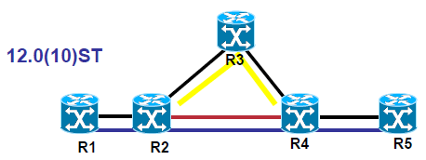
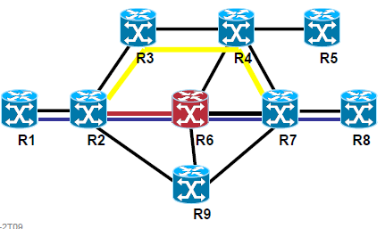
FRR – Local Repair
Local repair re-directs traffic to a backup LSP tunnel in response to a local failure.
Link protection: the NHOP backup tunnel end(MP) is one hop away from the PLR
Node protection : the NNHOP backup tunnel tail-end (MP) is two hops away from the PLR
Notes:
Obviously, an NNHOP backup tunnel also provides protection against a
failure of the immediate downstream link; thus, protection-wise, it is better than
an NHOP backup tunnel.

Slide 101
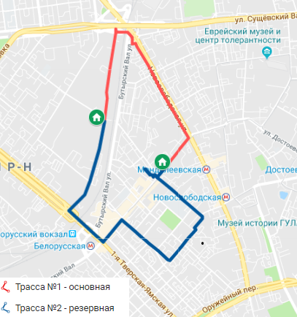
FRR local repair techniques: detour tunnel
Each LSP has its own detour LSP

Slide 102
FRR local repair techniques: Facility backup
Facility bypass tunnel provides protection against the failure of a link or node for all LSPs using the link/node
The facility bypass tunnel approach does reduce the amount of control plane state that is required.

Slide 103
FRR - restoration
There are two basic strategies for restoring the TE LSP to a full working path:
Global revertive mode: The head-end LSR of each tunnel is responsible for re-optimizing the TE LSPs that used the failed resource.
Local revertive mode: Upon detecting that the resource is restored, the PLR re-signals each of the TE LSPs that used to be routed over the restored resource.

Slide 104
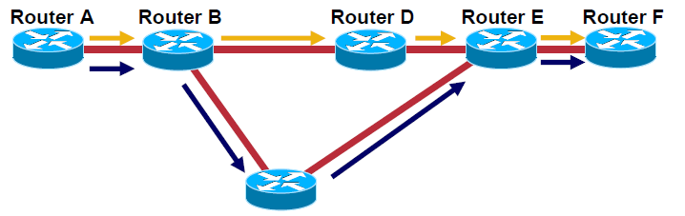
FRR – Path Protection
Link, Node protection: pre-establish 1 TE tunnel per {NHop/NNHop}
Path protection: pre-establish 2 LSPs for 1 TE tunnel, taking two diverse paths

Slide 105
Resources
RFC 3031 MPLS Architecture http://www.ietf.org/rfc/rfc3031.txt
CCIP: MPLS Study Guide http://shop.oreilly.com/product/9780782140965.do
GMPLS: Architecture and Applications by Adrian Farrel and Igor Bryskin http://www.amazon.com/dp/0120884224/ref=rdr_ext_tmb
MPLS: Next Steps, Volume 1 by Bruce S. Davie and Adrian Farrel http://www.amazon.com/MPLS-Volume-Morgan-Kaufmann-Networking/dp/0123744008/ref=sr_1_1?ie=UTF8&qid=1378571677&sr=8-1&keywords=mpls+next+steps

Slide 106
Questions?

